Slide 1


Md.Riadul Islam ID:1640CSE00467
Mohammad Ibrahim ID:1640CSE00514

Slide 2
Topic Of Presentation
1. Validation of tokens in a C program 2. Evaluation of Postfix Expression in C [Algorithm and Program]

Slide 3
Here you will get program to implement lexical analyzer in C.
Compiler is responsible for converting high level language in machine language. There are several phases involved in this and lexical analysis is the first phase.
Lexical analyzer reads the characters from source code and convert it into tokens.

Slide 4
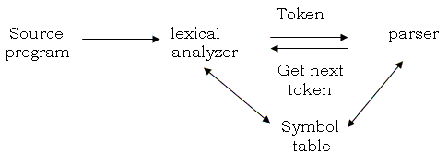
Different tokens or lexemes are:
Keywords
Identifiers
Operators
Constants
Take below example.
c = a + b

Slide 5
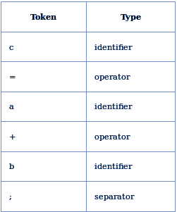
After lexical analysis a symbol table is :

Slide 6
Postfix Expression
Postfix expression is the form ABO
A and B are numbers or also postfix expression
O is operator ( +, -, *, /
From Postfix to Answer
The reason to convert infix to postfix expression is that we can compute the answer of postfix expression easier by using a stack.

Slide 7
Ex: 231*+9-
2
3
2
1
3
2
3
2
5
9
5
-4
3 | * | 1 | = | 3
3 | + | 2 | = | 5
5 | - | 9 | = | -4

Slide 8
Algorithm for Evaluation of Postfix Expression
Create an empty stack and start scanning the postfix expression from left to right.
If the element is an operand, push it into the stack.
If the element is an operator O, pop twice and get A and B respectively. Calculate BOA and push it back to the stack.
When the expression is ended, the value in the stack is the final.

Slide 9
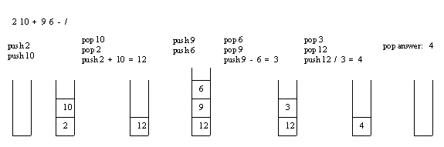
Evaluation of a postfix expression using a stack is explained in below example:

